Slide 1
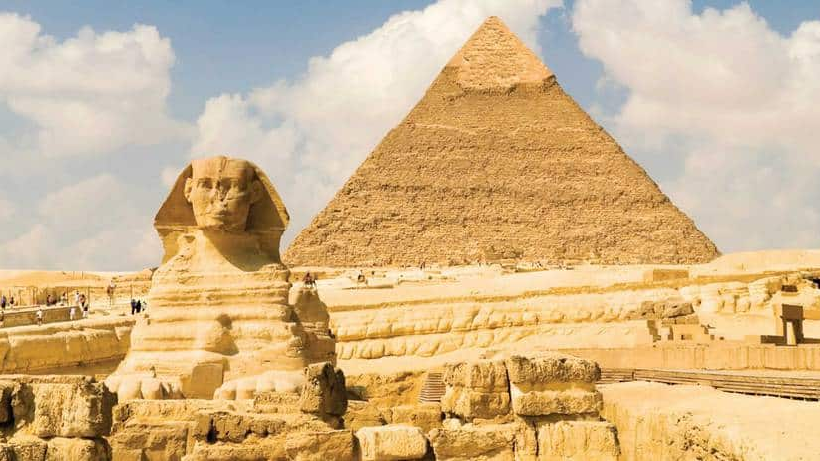


WELCOME TO EGYPT
EXCLUSIVE OFFER
*10 days/9 nights (*land arrangements)
From only USD$2500 per person twin share Ex Sydney
Includes:
Return Economy Class Airfares, Hotels 5*,
tours + so much more…
(*Subject to availability, seasonality, conditions may apply)
Valid from 1st Feb,23 to 31 Dec, 23
Enquiries: info@gatewaytravel.com.au
https://www.gatewaytravel.com.au/

